Slide 1
Network Monitoring Tools and Basic Security
Chapter 2

Slide 2
Learning Outcomes
Monitor and detect network security breaches by configuring Syslog, NTP.
Implement basic security on routers using AAA and SSH.

Slide 3
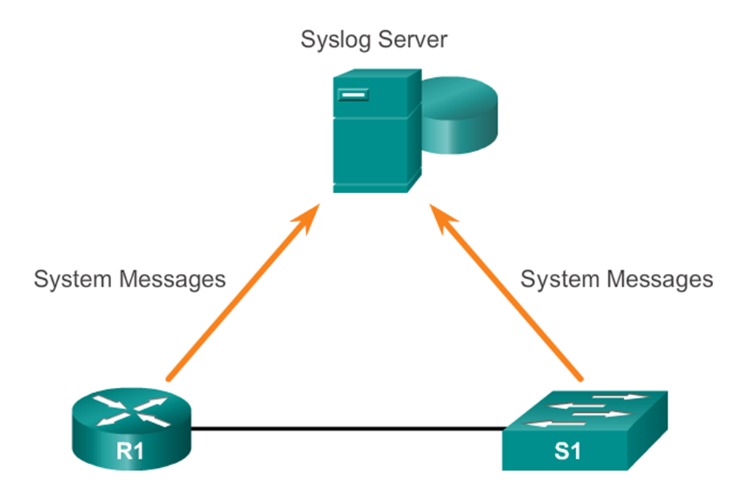
Why Monitor Network Devices?
Monitoring network devices will give us an early indication of a threat or vulnerability in the infrastructure.
By doing trend analysis or responding to alerts triggered by the monitoring systems, we will be able to prevent security breaches.
One of the most common network monitoring tool is called Syslog.

Slide 4
Syslog Service
Syslog is a tool which logs system messages generated by devices (printers, routers, switches etc) into an easily readable format.
IT operations staff will then use these reports for system management and security auditing as well as general information gathering, analysis and debugging.
In order to activate the service, a Syslog Server has to be setup and several devices have to be configured to send syslog messages to the server to log activity. How does a syslog message look like?

Slide 5

Syslog System Message Format
A timestamp: *Dec 18 17:10:15.079
The facility on the router that generated the message: %LINEPROTO
The severity level: 5
A mnemonic for the message: UPDOWN
The description of the message: Line protocol on Interface FastEthernet0/0, changed state to down

Slide 6
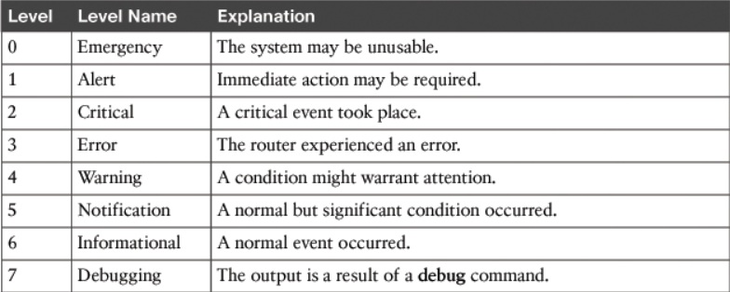
System Message Severity Levels

Slide 7
Configuring and Verifying Syslog Client
R1(config)#logging 192.168.1.101
This command configures R1 to send syslog messages to the syslog server with IP address 192.168.1.101.
R1(config)#logging trap 4 (non-PT)
This command tells the router to send messages which are trap/severity level 4 (warning messages) and below. The default level is 7 (All messages 7 and below)
R1# show logging
Shows logging parameters configured

Slide 8
Timestamping using NTP
Many features in a computer network depend on time synchronisation, such as accurate time information in syslog messages, certificate-based authentication in VPNs, ACLs with time range configuration, and key rollover in routing protocol authentication (EIGRP and RIP)
Devices such as routers and switches have an internal clock which has to either be manually synchronised or use a Network Time Protocol (NTP) automatically.

Slide 9
Network Time Protocol (NTP)
NTP is a protocol designed to time-synchronize a network of machines. NTP runs over UDP, which in turn runs over IP.
An NTP network usually obtains the time from an authoritative time source, such as a radio clock or an atomic clock attached to a time server. NTP then distributes this time across the network. NTP is extremely efficient; no more than one packet per minute is necessary to synchronise two machines to within 1msec of one another.
NTP uses the concept of a “stratum” to describe how many NTP “hops” away a machine is from an authoritative time source.
A “stratum 1” time server typically has a radio or atomic clock directly attached to the server; a “stratum 2” time server receives the time via NTP from a “stratum 1” time server.

Slide 10
NTP Security
NTP services are enabled on all interfaces by default.
The time that a machine keeps is a critical resource, so the security features of NTP should be used to avoid the accidental or malicious setting of incorrect time
To authenticate the associations with other systems for security purposes, use the commands in the “NTP Authentication Commands” table
Good Reads: https://ccie-or-null.net/2012/05/29/ntp/

Slide 11


Configuring NTP
NTP is automatically enabled on all Cisco devices. To disable NTP on a specific interface, use the ntp disable command in the interface configuration mode.
R1# show ntp status
Check NTP config on router
R1(config)#clock timezone GMT +8
R1(config)#ntp update-calendar
Config clock to be SG time
R1(config)#ntp logging (non-PT)
R1(config)#ntp server 10.1.1.1
Send the router logs to the NTP Server
NTP Server 10.1.1.1
Stratum 1
R1: Stratum 2

Slide 12

Securing NTP
R1(config)#ntp master 2 (non-PT)
Since R1 was at stratum 2 we configure it as master 2.
R1(config)#ntp authenticate
Activate the NTP Authentication.
R1(config)#ntp authentication-key 1 md5 nypsec
Router uses MD5 hash and authentication key “nypsec”. A client should have the same key in order for R1 server to send the time to it.
R1(config)#ntp trusted-key 1
A Router’s default trusted key is 0, i.e. no NTP authentication. So in order to change this, you need to define the above to take key 1.
R1: Stratum 2

Slide 13
Securing NTP Continued…
Sw1(config)#ntp logging
Sw1(config)#ntp server 10.1.1.1
Sw1(config)#ntp authenticate
Sw1(config)#ntp authentication-key 1 md5 nypsec
Sw1(config)#ntp trusted-key 1
The client switch configuration is as shown above.
Verify using the “sh ntp status” commands.
Note: PT doesn’t support NTP on Switches.
R1: Stratum 2

Slide 14
Authentication, Authorization, Accounting
AAA is a framework for controlling access to IT equipment, enforcing rights of access and providing info necessary for billing of services.
AAA is considered very important in network management and security.
Authentication: Provides a way to identify a user. If credentials match (username/password), user is given access.
Authorization: After gaining access, user must have rights to do certain tasks, like accessing database, issuing ‘del’ commands. Usually, this step is combined with the authentication process where user is only given certain access based on their credentials
Accounting: Measures the resources the user consumes during access for billing , trend analysis and capacity planning.
Notes:
Following authentication, a user must gain authorization for doing certain tasks. After logging into a system, for instance, the user may try to issue commands. The authorization process determines whether the user has the authority to issue such commands. Simply put, authorization is the process of enforcing policies: determining what types or qualities of activities, resources, or services a user is permitted. Usually, authorization occurs within the context of authentication. Once you have authenticated a user, they may be authorized for different types of access or activity.
The final plank in the AAA framework is accounting, which measures the resources a user consumes during access. This can include the amount of system time or the amount of data a user has sent and/or received during a session. Accounting is carried out by logging of session statistics and usage information and is used for authorization control, billing, trend analysis, resource utilization, and capacity planning activities.

Slide 15


AAA security
Authorization
which resources the user is allowed to access and which
operations the user is allowed to perform?
Authentication
Who are you?
Accounting
What did you spend it on?

Slide 16


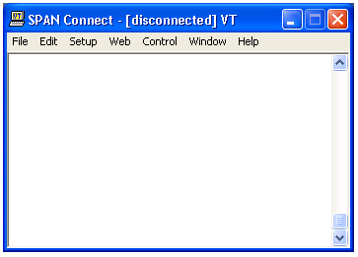
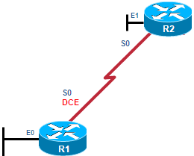
AAA Authentication – Line Passwords
User Access Verification
Password: cisco
Password: cisco1
Password: cisco12
% Bad passwords
Internet
R1(config)# line vty 0 4
R1(config-line)# password cisco
R1(config-line)# login
Uses a login and password combination on access lines
Easiest to implement, but most unsecure method
Vulnerable to brute-force attacks

Slide 17
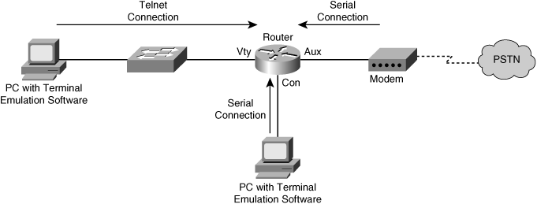
AAA Authentication: Line & Enable pwds
R1(config)# line vty 0 4
R1(config-line)# password cisco
R1(config-line)# login
R1(config)# line aux 0
R1(config-line)# password cisco
R1(config-line)# login
R1
R1(config)# line con 0
R1(config-line)# password cisco
R1(config-line)# login
R1(config)# enable secret cisco

Slide 18
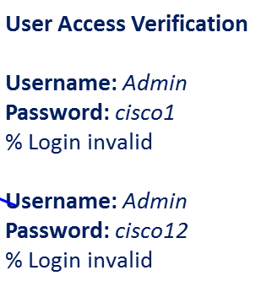


AAA Authentication- Self-Contained/Local
R1(config)# username Admin secret Str0ng5rPa55w0rd
R1(config)# line vty 0 4
R1(config-line)# login local
Remote Client
AAA
Router
1
2
3
Self-Contained AAA
The client establishes a connection with the router.
The AAA router prompts the user for a username and password.
The router authenticates the username and password using the local database.
The local database is created manually using “username” and “Secret” or “password” commands.
Used for small networks
Stores usernames and passwords locally in the Cisco router

Slide 19
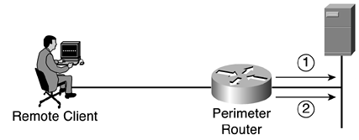
Server-Based AAA Authentication
Uses an external database server
  TACACS or RADIUS Server
  Microsoft Windows Server Network Policy Server
More appropriate if there are multiple routers
Remote Client
AAA
Router
Cisco Secure ACS Server
1
2
3
4
Server-Based AAA
The client establishes a connection with the router.
The AAA router prompts the user for a username and password.
The router authenticates the username and password using a remote AAA server.
The user is authorized to access the network based on information on the remote AAA Server.

Slide 20
Configuring AAA
R1#aaa new-model
Enable AAA features by using the global configuration command. By default it is off.
R1#aaa authentication type default | list-name method1,…
Type | Interfaces affected | Method
login:- enables AAA for logins on TTY,VTY and consoles | Default method is auto applied to all interfaces | Local, enable or line (within the router/sw)
enable:- enables AAA for EXEC mode access | Named lists to specific interfaces only | Group tacacs+, radius, kerberos (external servers)

Slide 21
AAA Examples (local default)
R1# conf t
R1(config)# username JR-ADMIN secret Str0ngPa55w0rd
R1(config)# username ADMIN secret Str0ng5rPa55w0rd
R1(config)# aaa new-model
R1(config)# aaa authentication login default local enable
R1(config)# line con 0
R1(config-line)# login authentication default
Creating the local database with username/password
Enables AAA features
Enables AAA features on all VTY and Con lines using local database as 1st authentication method. Failing which, enable passwords will be used as 2nd authentication method

Slide 22
AAA Example (local named-list)
R1# conf t
R1(config)# username JR-ADMIN secret Str0ngPa55w0rd
R1(config)# username ADMIN secret Str0ng5rPa55w0rd
R1(config)# aaa new-model
R1(config)# aaa authentication login TELNET-LOGIN enable
R1(config)# line vty 0 4
R1(config-line)# login authentication TELNET-LOGIN
Enables AAA features on only VTY lines 0 to 4 using enable password the authentication method.
Using enable password to authenticate

Slide 23
Server-Based AAA Authentication
Specify the location of the AAA server that will provide AAA services.
Configure the encryption key needed to encrypt the data transfer between the network access server and Cisco Secure ACS.

Slide 24
AAA Configuration Commands
Command | Description
tacacs-server host ip-address single-connection | Indicates the address of the TACACS server and specifies use of the TCP single-connection feature of Cisco Secure ACS.
tacacs-server key key | Establishes the shared secret encryption key between the network access server and the Cisco Secure ACS server.
radius-server host ip-address | Specifies a RADIUS AAA server’s IP Address.
radius-server key key | Specifies an encryption key to be used with the RADIUS AAA server.

Slide 25



Configuring the AAA Server Parameters
192.168.1.100
RADIUS Server
R1
TACACS+ Server
192.168.1.101
R1(config)# aaa new-model
R1(config)#
R1(config)# tacacs-server host 192.168.1.101
R1(config)# tacacs-server key TACACS+Pa55w0rd
R1(config)#
R1(config)# radius-server host 192.168.1.100
R1(config)# radius-server key RADIUS-Pa55w0rd
Notes:
25

Slide 26
Define Method Lists
R1(config)# aaa authentication login default ?
enable Use enable password for authentication.
group Use Server-group
krb5 Use Kerberos 5 authentication.
krb5-telnet Allow logins only if already authenticated via Kerberos V
Telnet.
line Use line password for authentication.
local Use local username authentication.
local-case Use case-sensitive local username authentication.
none NO authentication.
passwd-expiry enable the login list to provide password aging support
R1(config)# aaa authentication login default group ?
WORD Server-group name
radius Use list of all Radius hosts.
tacacs+ Use list of all Tacacs+ hosts.
R1(config)# aaa authentication login default group

Slide 27
AAA Authentication Commands
R1(config)# aaa authentication login default group tacacs+ group radius local-case
Parameter | Description
default | This command creates a default that is automatically applied to all lines and interfaces, specifying the method or sequence of methods for authentication.
group group-name group radius group tacacs+ | These methods specify the use of an AAA server. The group radius and group tacacs+ methods refer to previously defined RADIUS or TACACS+ servers. The group-name string allows the use of a predefined group of RADIUS or TACACS+ servers for authentication (created with the aaa group server radius or aaa group server tacacs+ command).

Slide 28
Configuring the AAA Server
192.168.1.100
RADIUS Server
R1
TACACS+ Server
192.168.1.101
Cisco Secure ACS
Solution Engine
using TACACS+
R1(config)# aaa new-model
R1(config)# tacacs-server host 192.168.1.101 single-connection
R1(config)# tacacs-server key TACACS+Pa55w0rd
R1(config)# radius-server host 192.168.1.100
R1(config)# radius-server key RADIUS-Pa55w0rd
R1(config)#
R1(config)# aaa authentication login default group tacacs+ group radius local-case
Notes:
28

Slide 29
Other statements
(conft)#login block-for statement 600 attempts 5 within 30
This command will block users from logging in for 600sec if there have been 5 failed login tries within 30sec span.
(config-line)# transport input ssh
(config-line)# transport input telnet
The first command only allows ssh as the remote login method into the router and blocks telnet. By default both telnet and ssh are allowed. You can also specify to allow only telnet as stated in the second command.

Slide 30
Secure Shell (SSH)
Secure Shell (SSH) is a cryptographic network protocol for operating network services securely over an unsecured network.
SSH was initially designed as a replacement for Telnet (the remote access protocol).
But Telnet sends information (esp passwords) in cleartext, rendering them susceptible to piracy attacks.
[source :Wikipedia]

Slide 31
SSH Authentication and Encryption
Cisco routers and switches that use SSH, need a RSA public/private key pair to be created to perform authentication of users.
By default, an RSA key name is composed of the device’s hostname and domain name specified in the configuration.
There are ways to define your own RSA keypair name if the default way is not favourable.
https://learningnetwork.cisco.com/thread/70783
DES or 3DES is used for encryption of payload (data traffic) in SSHv2.
Notes:
Router1(config)#do sh run | in hostname|domain name
hostname Router1
ip domain name lan1.company.com
Router1#show crypto key mypubkey rsa
<output omitted>
Key name: Router1.lan1.company.com
<output omitted>
Finally please keep in mind that you can associate manually a different rsa key to be used with ssh as well, to do so, you would use the command "ip ssh rsa keypair-name", example:

Slide 32
Configuring SSH
Step 1: Configure the IP domain name & host name
Step 2: Generate one-way secret RSA keys.
Step 3: Create a local database username entry.
Step 4: Enable VTY inbound SSH sessions.
R1# conf t
R1(config)# hostname R1
R1(config)# ip domain-name span.com
R1(config)# crypto key generate rsa general-keys modulus 1024
The name for the keys will be: R1.span.com
% The key modulus size is 1024 bits
% Generating 1024 bit RSA keys, keys will be non-exportable...[OK]
R1(config)# username Bob secret cisco
R1(config)# line vty 0 4
R1(config-line)# login local
R1(config-line)# transport input ssh
R1(config-line)# exit
Only allow SSH way to login via vty. No Telnet allowed
Notes:
32

Slide 33
Optional SSH Commands
R1# show ip ssh
SSH Enabled - version 1.99
Authentication timeout: 120 secs; Authentication retries: 3
R1#
R1# conf t
Enter configuration commands, one per line. End with CNTL/Z.
R1(config)# ip ssh version 2
R1(config)# ip ssh authentication-retries 2
R1(config)# ip ssh time-out 60
R1#
R1# show ip ssh
SSH Enabled - version 2.0
Authentication timeout: 60 secs; Authentication retries: 2
R1#
SSHv2 has better encryption ciphers like 3DES and AES. They also support public key certificates.
After 2 wrong username/password tries, the equipment will time out all login sessions for 60 sec.
Notes:
33

Slide 34
THE END

